Slide 1
Vulkan introduction
And before that a small self-introduction, caveats and other boringness.

Slide 2
Before we get started…
I am aware your roster says 4 hours
You’re not going to sit there all afternoon listening to babby’s first lecture
Expectation is lecture < 2 hrs
Remaining 2 hrs:
Questions!
Answers!
… And a little challenge 😉

Slide 3

… After we finish
If there’s any questions about Vulkan, I MIGHT have an answer
Not guaranteed to be the one you’re looking for…
… But available regardless 😉
Find this horrifying face on Slack:
… Or mail me at rick.van.miltenburg@gmail.com
… Or contact me… in some other way

Slide 4
Rendering basics
Or at least a bunch of very shallow dives in the hope of getting those of you new to the field of graphics up to a basic enough level of understanding.

Slide 5
Rendering basics
This workshop is not intended for pure beginners…
… But for those of you who are, we’ll blitz through the basics
Further research is highly encouraged
Books (Real-Time Rendering, Game Engine architecture etc)
Tutorials online
Ask your lecturers whether more graphics tutorials are right for you

Slide 6
Rendering basics
3D models divided into primitives
Commonly triangles
Each primitive consists of a number of vertices
Vertices can be indexed for reuse
Vertices can have multiple attributes aside from position
Eg texture coordinate
3
0
1
2

Slide 7
Rendering basics
Direct3D / OpenGL
+1, +1
-1, +1
GPU’s don’t render in “3D”
… Except for 3D monitors and VR… Ish
All geometry must be converted to 2D
Graphics API use
“Normalized device coordinates”
Vulkan always orients top -> down
Depth range is [0, 1]
-1, -1
+1, -1
Vulkan
-1, -1
+1, -1
-1, +1
+1, +1

Slide 8
Rendering basics
Normalized device coordinates cannot be moved
NOT: “The camera moves around the world”
BUT: “The world moves around the camera”
Objects can be projected in 2D in a number of ways, commonly:
Perspective: An object twice as far is half the size on-screen (x,y / z)
Orthographic: No matter the distance, the size stays the same (x,y)
Commonly handled by matrices (view, projection respectively)

Slide 9
Rendering basics
The position of vertices is determined by a Vertex shader
The pixels in between are all determined by the hardware
The resulting pixels are colored by a Fragment shader
The shaders are written in a shader language
For example: GLSL, HLSL, Cg etc
In the case of Vulkan: SPIR-V

Slide 10
Rendering basics
The resulting texels are rendered to a Color Attachment/Buffer
This can be a backbuffer of a window
Or another manually generated image
This information can be reused in later stages
Think of effects like blurring the screen etc
The depth of the texels are rendered to a Depth Attachment/Buffer
Preventing objects “further away” from ending up on top
Can also be used for shadow mapping and the such

Slide 11
Vulkan
How did we end up here?

Slide 12
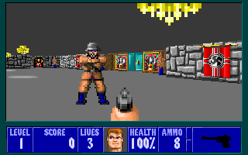
The olden days
Remember this beauty?
Welcome back to the glorious
times of 320x240 resolution
Glorious 0.0768 MegaPixels
1080p is just over 2 MegaPixels (2.0736 MP => 27x as many pixels)
Rendering was done on the CPU
GPUs weren’t really a thing at the time

Slide 13
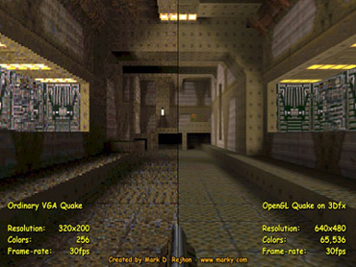
Advent of GPUs
As prices of GPUs dropped, the amount of GPUs rose
Using GPUs required APIs
Glide
OpenGL
DirectX
All primarily designed for compatibility
Welcome to the wild west of new technology

Slide 14
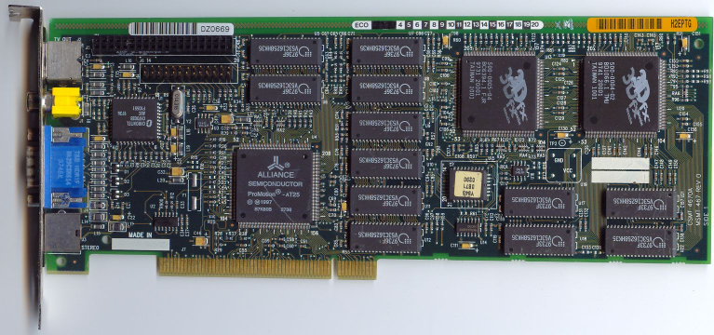
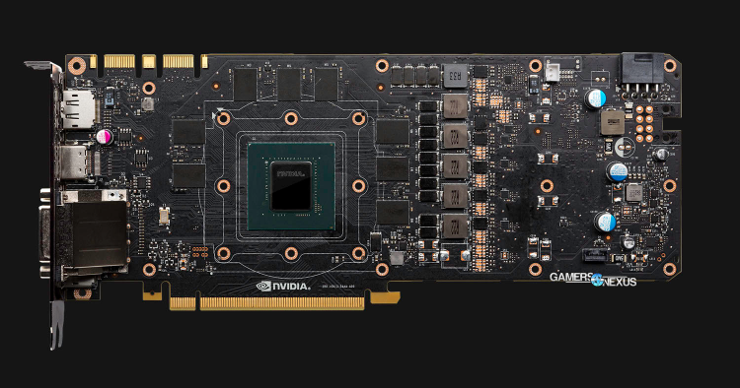
GPU evolution
GPUs eventually evolved
At first: Hardware transform & lighting
Later on: Full-fledged graphics processors
Exotic functionality became mainstream
(2001) Vertex & Pixel shaders
(2007) Geometry shaders
(2009) Tessellation & Compute / GPGPU
Direct3D mostly ended up dominant
(All of the above dates also refer to Direct3D adoption dates)
Vertex / Pixel Shaders for example only core in OpenGL since ~2004

Slide 15
Meanwhile, in CPU land…
Single-core performance increases year/year started to decline
No more free lunch! ☹️
Multi-core CPUs started to become prevalent
… But graphics API were thoroughly designed for single-core use
Direct3D 11 provided some fairly decent multi-core functionality
But almost all processing still ended up on a single core
OpenGL… well… Let’s not even touch that one here.

Slide 16
Meet Vulkan (and Direct3D 12)
Fundamentally designed to:
Reduce CPU overhead
Increase multithreading potential
(Nuke OpenGL from orbit. I’m not biased, where do you get that idea from?)
Expose more information about the application / intent
Meaning the driver has more to go on and less to assume/predict
It is the future we live in
But a little more is expected from us humble programmers

Slide 17
… Small caveat
Hardware / software compatibility is… Not quite there yet
 | AMD | Nvidia | Intel | Software
Windows | ✓ | ✓ | ❌* | ?
Mac | ❌ | ❌ | ❌ | ❌
Linux | ✓ | ✓ | ✓ | ✓
Android | ✓ (Android Nougat+, <1% currently), ❌* (< Nougat)
iOS | ❌
? = None that I know of
❌* = Sort of, ish. Intel released 2 Beta drivers in past May and June. Not in main driver, and no new betas…
Some Android phones have a separate implementation (eg Samsung Galaxy S7) below Nougat
❌ = Apple (They put the pedal to the Metal, and gave the boot to Vulkan) [Commercial 3rd party solution]

Slide 18
Basic code walkthough
Presumably the easiest way to explain the most important parts of the API without diving straight into a brick wall

Slide 19
Code walkthrough
Obvious place to start would be initialization
… Or would it?
We’ll start by explaining the basic rendering loop first
Serious recommendation to try and plan your render loop before the rest of the application
Initialization is just preparing for the actual rendering after all!
And cleanup is entirely unnecessary until you have a functioning renderer and start creating objects dynamically ☺️

Slide 20
Code walkthrough - Rendering
vkAcquireNextImageKHR ( swapchain, backbufferSemaphore )
vkBeginCommandBuffer ( cmdBuffer )
vkCmdBeginRenderPass ( cmdBuffer, renderpass, framebuffer )
vkCmdBindPipeline ( cmdBuffer, pipeline )
vkCmdBindDescriptorSets ( cmdBuffer, descriptorSet, pipelineLayout )
vkCmdBindVertexBuffers ( cmdBuffer, vertexBuffer )
vkCmdBindIndexBuffers ( cmdBuffer, indexBuffer )
vkCmdDrawIndexed ( cmdBuffer )
vkCmdEndRenderPass ( cmdBuffer )
vkEndCommandBuffer ( cmdBuffer )
vkQueueSubmit ( cmdBuffer, queue, backbufferSemaphore )
vkQueuePresentKHR ( swapchain, queue )

Slide 21
Code walkthrough - Rendering
vkAcquireNextImageKHR ( swapchain, backbufferSemaphore )
vkBeginCommandBuffer ( cmdBuffer )
vkCmdBeginRenderPass ( cmdBuffer, renderpass, framebuffer )
vkCmdBindPipeline ( cmdBuffer, pipeline )
vkCmdBindDescriptorSets ( cmdBuffer, descriptorSet, pipelineLayout )
vkCmdBindVertexBuffers ( cmdBuffer, vertexBuffer )
vkCmdBindIndexBuffers ( cmdBuffer, indexBuffer )
vkCmdDrawIndexed ( cmdBuffer )
vkCmdEndRenderPass ( cmdBuffer )
vkEndCommandBuffer ( cmdBuffer )
vkQueueSubmit ( cmdBuffer, queue, backbufferSemaphore )
vkQueuePresentKHR ( swapchain, queue )

Slide 22
Swapchain
x
vkAcquireNextImageKHR ( swapchain, backbufferSemaphore )
…
vkQueuePresentKHR ( swapchain, queue )
Presented
Holds multiple backbuffers
Contents of backbuffer shown on window
While one backbuffer is shown on the window, another can be rendered to in the meantime
2 or 3 backbuffers is standard
vkQueuePresentKHR
Writable
vkAcquireNextImageKHR
Queued

Slide 23
Code walkthrough - Rendering
vkAcquireNextImageKHR ( swapchain, backbufferSemaphore )
vkBeginCommandBuffer ( cmdBuffer )
vkCmdBeginRenderPass ( cmdBuffer, renderpass, framebuffer )
vkCmdBindPipeline ( cmdBuffer, pipeline )
vkCmdBindDescriptorSets ( cmdBuffer, descriptorSet, pipelineLayout )
vkCmdBindVertexBuffers ( cmdBuffer, vertexBuffer )
vkCmdBindIndexBuffers ( cmdBuffer, indexBuffer )
vkCmdDrawIndexed ( cmdBuffer )
vkCmdEndRenderPass ( cmdBuffer )
vkEndCommandBuffer ( cmdBuffer )
vkQueueSubmit ( cmdBuffer, queue, backbufferSemaphore )
vkQueuePresentKHR ( swapchain, queue )

Slide 24
Command buffer
vkBeginCommandBuffer ( cmdBuffer )
…
vkEndCommandBuffer ( cmdBuffer )
Records a set of commands to be executed by the driver/GPU
Commands are not executed straight away
Command buffer has to be “submitted”…
… But can also be “submitted” multiple times
All vkCmd… commands are RECORDED on command buffers
Notes:
It is worth noting that all commands starting with “vkCmd” are recorded. As such, their effect is not immediate, but they add instructions to be performed by the command buffer once submitted.

Slide 25
Code walkthrough - Rendering
vkAcquireNextImageKHR ( swapchain, backbufferSemaphore )
vkBeginCommandBuffer ( cmdBuffer )
vkCmdBeginRenderPass ( cmdBuffer, renderpass, framebuffer )
vkCmdBindPipeline ( cmdBuffer, pipeline )
vkCmdBindDescriptorSets ( cmdBuffer, descriptorSet, pipelineLayout )
vkCmdBindVertexBuffers ( cmdBuffer, vertexBuffer )
vkCmdBindIndexBuffers ( cmdBuffer, indexBuffer )
vkCmdDrawIndexed ( cmdBuffer )
vkCmdEndRenderPass ( cmdBuffer )
vkEndCommandBuffer ( cmdBuffer )
vkQueueSubmit ( cmdBuffer, queue, backbufferSemaphore )
vkQueuePresentKHR ( swapchain, queue )

Slide 26
Framebuffers
Color target(s)
vkCmdBeginRenderPass ( cmdBuffer, renderpass, framebuffer )
…
vkCmdEndRenderPass ( cmdBuffer )
Describes a combination of “attachments” for use in a specific renderpass
Simply put, an “attachment” can be a render target or depth render target
The exact combination of attachments and renderpass need to be known during creation
Framebufer
Depth buffer
Renderpass

Slide 27
Render passes
vkCmdBeginRenderPass ( cmdBuffer, renderpass, framebuffer )
…
vkCmdEndRenderPass ( cmdBuffer )
Describes:
The steps of the rendering process (“sub”-passes)
The color- and/or depth targets to be used as inputs and/or outputs
The dependencies between the stages and their inputs/outputs
Requires specifying a lot of information ahead-of-time…
… But may allow the driver room for optimizations
Render operations can only take place in render passes

Slide 28
Render passes – Sample renderpass
ate
Objects
Buffers
Clear & Render
Intermediate
Backbuffer
Sample
Backbuffer
Render
Backbuffer
Fwd Pipeline
Depth buffer
Post Pipeline

Slide 29
Render passes – Sample renderpass walkthrough
Simplified immediate mode GPU walkthrough
ate
Objects
Buffers
Intermediate
Backbuffer
Backbuffer
Backbuffer
Fwd Pipeline
Depth buffer
Post Pipeline
Objects rendered one-by-one
When done:
Full-screen post-processing!!!
Rendering as passed on from generation to generation
This is called “Immediate Mode Rendering”
Easy to confuse with other meanings of “immediate mode”
Common on desktop GPUs

Slide 30
Render passes – Sample renderpass walkthrough
Simplified tiled GPU walkthrough
ate
Objects
Buffers
Intermediate
Backbuffer
Backbuffer
Backbuffer
Fwd Pipeline
Depth buffer
Post Pipeline
Tiled renderers
Process the entire renderpass tile-by-tile
Faster on memory-constrained hardware
Common on mobile
Nvidia Maxwell (9xx) and onward

Slide 31
Render passes
ate
Objects
Disadvantages:
Extra work; Working from scratch takes significantly longer
Subpasses and dependencies must be clear beforehand
Advantages:
Increased optimization opportunities for (tiled) GPUs
Forces the developer to put more thought into the rendering process
Buffers
Intermediate
Backbuffer
Backbuffer
Backbuffer
Fwd Pipeline
Depth buffer
Post Pipeline
By describing a complete set of subpasses in advance, render passes provide the implementation an opportunity
to optimize the storage and transfer of attachment data between subpasses.
In practice, this means that subpasses with a simple framebuffer-space dependency may be merged into a single
tiled rendering pass, keeping the attachment data on-chip for the duration of a render pass instance.
- Vulkan specification 1.0.35 (vkspec.pdf)

Slide 32
Code walkthrough - Rendering
vkAcquireNextImageKHR ( swapchain, backbufferSemaphore )
vkBeginCommandBuffer ( cmdBuffer )
vkCmdBeginRenderPass ( cmdBuffer, renderpass, framebuffer )
vkCmdBindPipeline ( cmdBuffer, pipeline )
vkCmdBindDescriptorSets ( cmdBuffer, descriptorSet, pipelineLayout )
vkCmdBindVertexBuffers ( cmdBuffer, vertexBuffer )
vkCmdBindIndexBuffers ( cmdBuffer, indexBuffer )
vkCmdDrawIndexed ( cmdBuffer )
vkCmdEndRenderPass ( cmdBuffer )
vkEndCommandBuffer ( cmdBuffer )
vkQueueSubmit ( cmdBuffer, queue, backbufferSemaphore )
vkQueuePresentKHR ( swapchain, queue )

Slide 33
Code walkthrough – (Graphics*) Pipelines
* = We don’t cover the compute variant
Graphics pipelines just referred to as “pipeline” for brevity
vkCmdBindPipeline ( cmdBuffer, pipeline )
Describes how render operations should behave
Controls many aspects of rendering, including (but not limited to):
What type of primitives are we drawing? | What shaders do we use?
Where do we get our primitive data from? | What regions of the screen do we cover?
How should the pixels be rendered? | Do we overwrite previous data of blend it?
Should there be some form of depth testing? | Do we use multisampling?

Slide 34
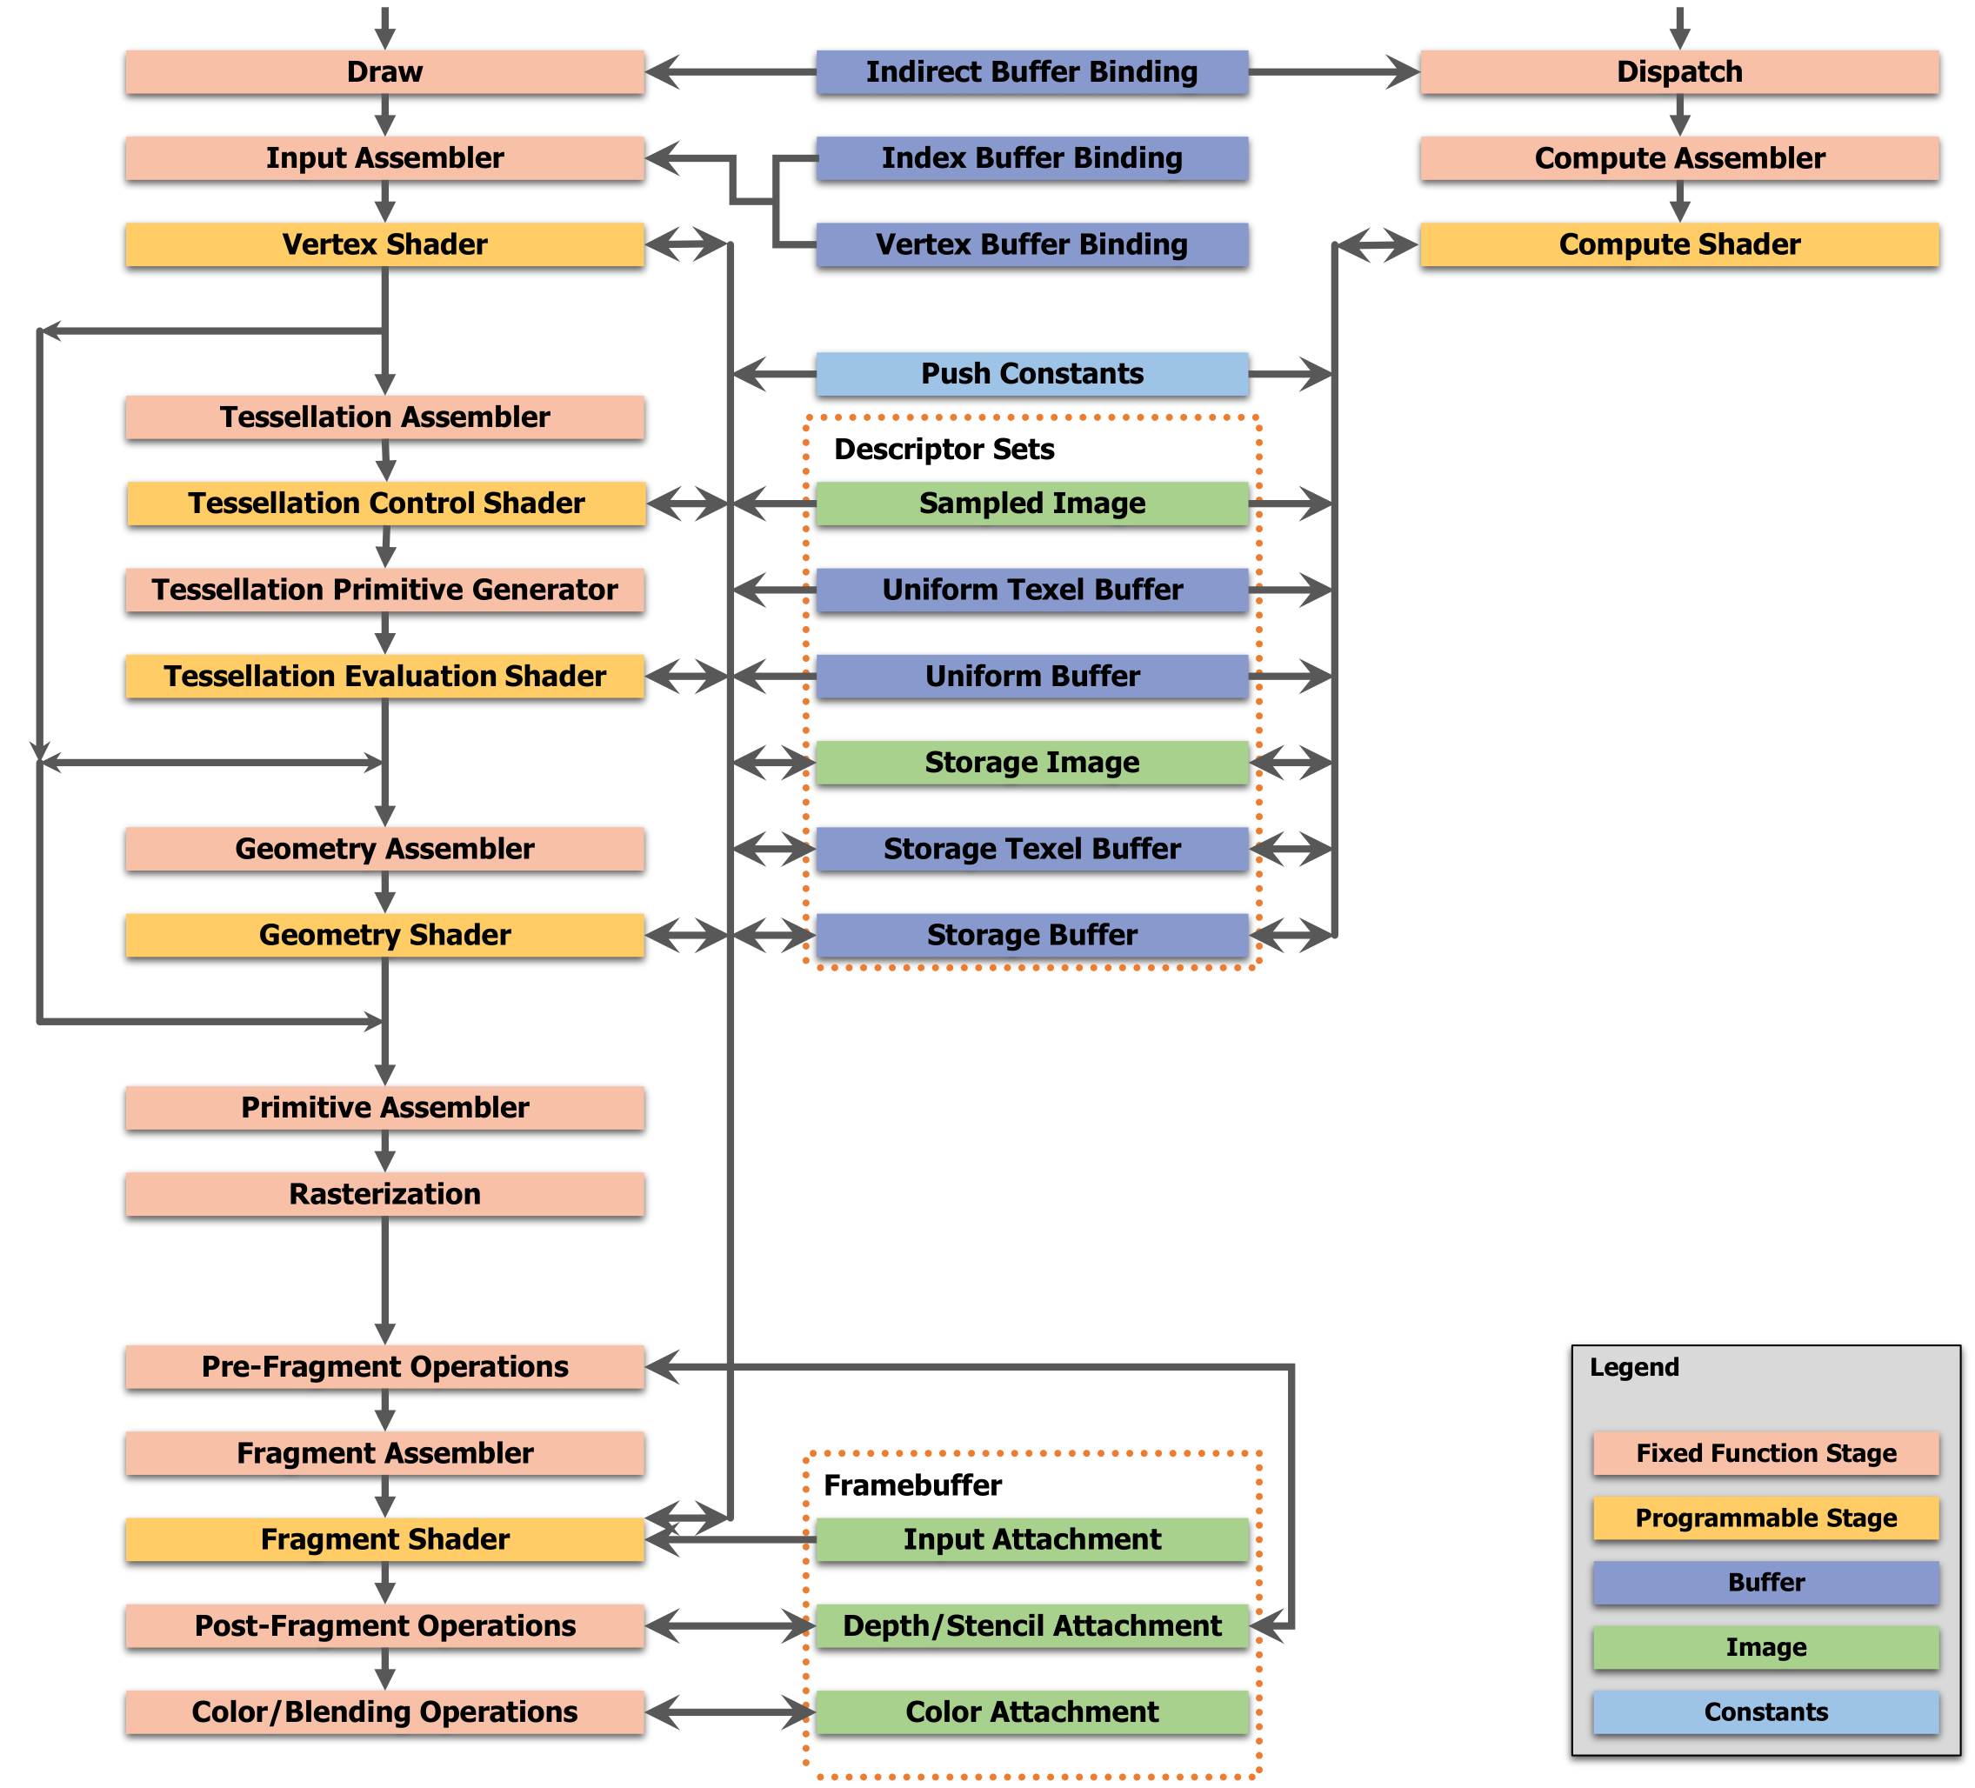
Code walkthrough – (Graphics) Pipelines
… This is a 3 4 hour workshop
Time to trim some fat
R.I.P Compute
R.I.P Tessellation
R.I.P Geometry shader
R.I.P Shader Read/Write resources

Slide 35
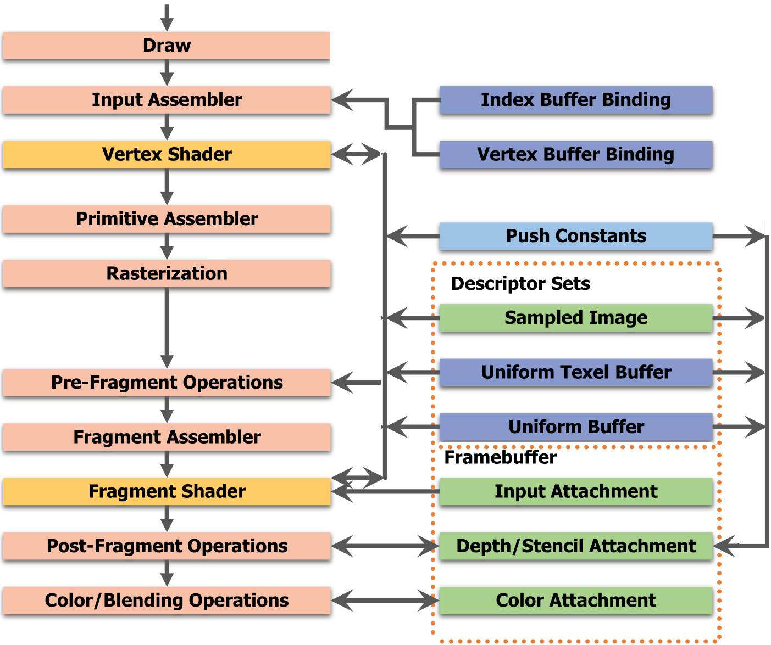
Code walkthrough – (Graphics) Pipelines
Stages reduced to normal rendering only
Omitted stages are definitely worth looking at
Just not before we understand how to get stuff on screen
(And I wasn’t sure the previous slide would be readable on the beamer~)

Slide 36
Code walkthrough – (Graphics) Pipelines
vkCmdDrawIndexed
.pInputAssemblyState
vkCmdBindIndexBuffers
.pStages
vkCmdBindVertexBuffers
.pVertexInputState
vkCmdPushConstants
.pRasterizationState
.pMultisampleState
.pViewportState
vkCmdBind-
DescriptorSets
.pStages
.pDepthStencilState
.pColorBlendState
vkCmdBeginRenderPass
Notes:
In here we now see all of the remaining functions of the render function inside vkBeginRenderPass and how they relate to the render pipeline at large.
All “dot-prefixed” properties mentioned here refer to properties set when the graphics pipeline was created. They are roughly correlated to the appropriate pipeline stages.

Slide 37
Code walkthrough - Rendering
vkAcquireNextImageKHR ( swapchain, backbufferSemaphore )
vkBeginCommandBuffer ( cmdBuffer )
vkCmdBeginRenderPass ( cmdBuffer, renderpass, framebuffer )
vkCmdBindPipeline ( cmdBuffer, pipeline )
vkCmdBindDescriptorSets ( cmdBuffer, descriptorSet, pipelineLayout )
vkCmdBindVertexBuffers ( cmdBuffer, vertexBuffer )
vkCmdBindIndexBuffers ( cmdBuffer, indexBuffer )
vkCmdDrawIndexed ( cmdBuffer )
vkCmdEndRenderPass ( cmdBuffer )
vkEndCommandBuffer ( cmdBuffer )
vkQueueSubmit ( cmdBuffer, queue, backbufferSemaphore )
vkQueuePresentKHR ( swapchain, queue )

Slide 38
Code walkthrough - Queues
vkQueueSubmit ( cmdBuffer, queue, backbufferSemaphore )
vkQueuePresentKHR ( swapchain, queue )
Controls submission of actual GPU tasks
Always functions asynchronously
All functions prefixed “vkQueue” are submitted to queues
Queues have various capabilities
Graphics | Compute | Transfer | Sparse binding | Present*
* = Queue present capabilities evaluated on a per-surface basis

Slide 39
Code walkthrough - Queues
vkQueueSubmit ( cmdBuffer, queue, backbufferSemaphore )
vkQueuePresentKHR ( swapchain, queue )
CPU
GPU Q1
Acquire
Cmd #1
Begin
Present
…
Cmd #1
End
…
Q Submit
Q Present
Acquire
Wait
…

Slide 40
Code walkthrough - Rendering
That was the core render loop in review ☺️

Slide 41
We’re not done yet
But a life is not worth living if there is no coffee to reward us for the effort we occasionally try to fit into it!

Slide 42
On the last episode…
We walked through basic graphics, an intro to Vulkan, a bummer of a compatibility note and the basic render loop.

Slide 43
Basic code walkthrough Episode 2: Attack of the Initialization
Don’t worry, no man named George touched this episode.

Slide 44
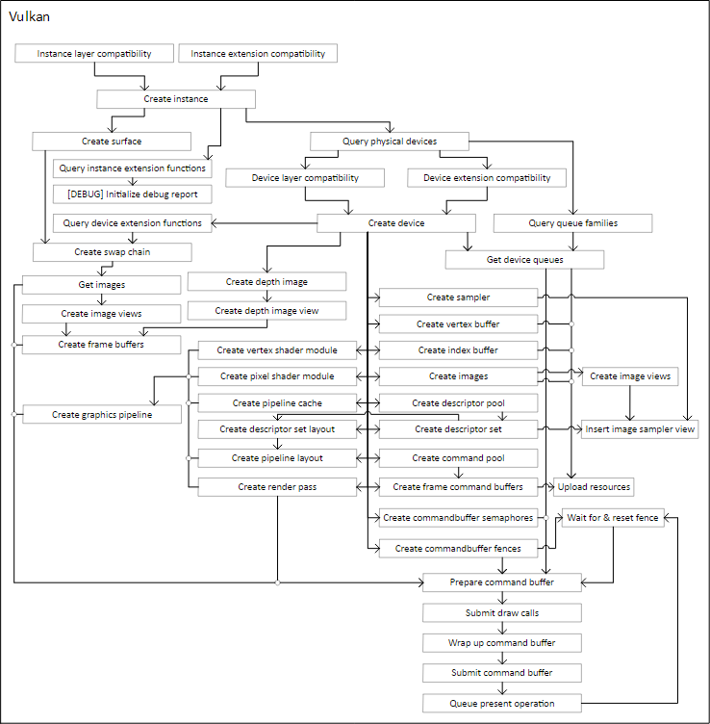
Diagram time!
(WARNING) I made this diagram a while ago, and haven’t gotten to improve it yet.
But it essentially sort of describes the order of operations and dependency chains in Vulkan
I believe it can be useful, but there are a few known mistakes and imperfections.

Slide 45
Initialization
Easily the most time-consuming part of a Vulkan application
Not all of it in these slides
Source code should be navigable
… Enough..?!?
We’ll switch to Visual Studio a little bit on
Not that long left until the dude near the beamer lets you do the fun stuff!

Slide 46
Layers and extensions
Layers and extensions are core to the Vulkan architecture
Extensions were in OpenGL as well, but they are decently implemented this time around
Layers are completely new
Extensions extend Vulkan with optional functionality
Extra functions, modes for existing functions and structures for create funcs
… But can also include fundamental things, such as the Swapchain

Slide 47
Layers and extensions
Layers are different
Layers are intended to intercept function calls
In a cross-platform way
Without nasty hooking behavior
Vulkan has done the ultimate optimization for debug messages:
Just remove them. All of them.
Instead, they are implemented in layers during the function intercepts
Provides parity of debug information regardless of implementation
Makes all debug functionality optional; Stripping it from the release build.

Slide 48
Layers and extensions
Debug messages is not the only purpose, however!
A layer could record all function calls for later replay (eg Renderdoc)
A layer could insert an overlay (eg the Steam overlay)
A layer could capture the state of the backbuffer before presenting (for eg screenshots)
Above all, none of these need any added code in the application itself.
Only their name needs to be added to vkCreateInstance
… Unless it is an implicit layer, and included automatically

Slide 49
Layers and extensions
vkEnumerateInstanceLayerProperties
vkEnumerateInstanceExtensionProperties
These functions are called before an instance is created
They list the amount of layers and extensions available
… It really isn’t wise to enable ALL of them. Select them manually.
The layers and extensions to be enabled are passed into vkCreateInstance

Slide 50
Layers and extensions
Extensions might need more information than the original functions might give them
Rather than dozens of similar functions (like in OpenGL) most parameters in create functions in Vulkan are expressed in structures
These structures can be linked with the .pNext member of these structures

Slide 51
Layers and extensions
// Note: Does not compile in C++ (compound literals & designated initializers)
vkCreateDevice (
outDevice->physical,
&(VkDeviceCreateInfo){
.sType = VK_STRUCTURE_TYPE_DEVICE_CREATE_INFO,
.pNext = &(VkSomeExtStructure){
.sType = VK_STRUCTURE_TYPE_SOME_EXT_STRUCTURE,
.pNext = &(VkSomeExt2Structure){
.sType = VK_STRUCTURE_TYPE_SOME_EXT2_STRUCTURE,
},
},
.queueCreateInfoCount = queueCount,
.pQueueCreateInfos = deviceQueueCreateInfos,
.enabledExtensionCount = requiredDeviceExtensionCount,
.ppEnabledExtensionNames = requiredDeviceExtensions,
},
NULL,
&outDevice->device
);

Slide 52
The Instance
Which gets us to the concept of the “Instance”
The instance is the core object from which all other Vulkan objects are created
Intended to eliminate global dependencies
One instance shouldn’t be different from another assuming the same parameters are passed, nor would you need more than one

Slide 53
Devices
Two types of devices:
Physical: Simply a handle pointing to a physical device, enumerated from an instance, allowing a logical device to be created and shared properties to be queried (eg memory available on the device)
Logical: The actual device object you create and use for resource creation and deletion. Most other objects are in the scope of the logical device.
A logical device can have multiple extensions enabled
Similar to instances
(LEGACY) Devices also used to have layers, but this is deprecated

Slide 54
Let’s move on to code
Most other concepts are probably best explained using the codebase itself
(Insert Git/SVN/Perforce/??? Link for allowing people to clone and inspect the codebase for themselves)

Slide 55
Pre-workshop: The practical advice
As opposed to that awful non-practical advice

Slide 56
Debug layers
As previously stated, debug layers are shipped with the SDK and easily enabled
… But there are some crashes and invalid error messages in some cases
One example to be reported soon-ish: Passing a vertex shader module with a “main” function into a graphics pipeline and specifying it as a fragment shader will give the error “Entrypoint ‘main’ does not exist”. It does, it’s just the wrong shader type.
Crashes on some parameters due to some lacking NULL checks etc

Slide 57
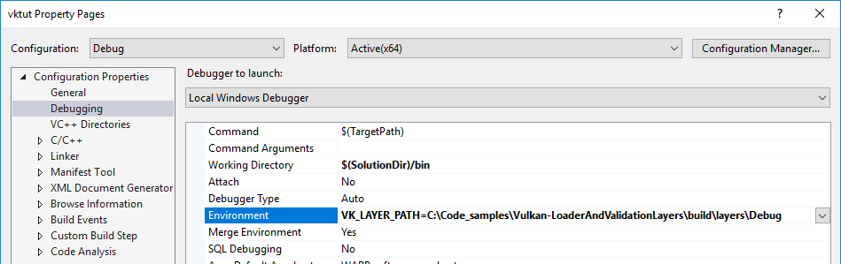
Debug layers
How to save tons of time otherwise spent on these issues:
Clone repository
Compile debug layers manually
Change the layer directory in the environment variables (VK_LAYER_PATH)
Will properly resolve breakpoints & call stacks
Bonus: Allows new commits in Github to be applied without waiting for updates!

Slide 58
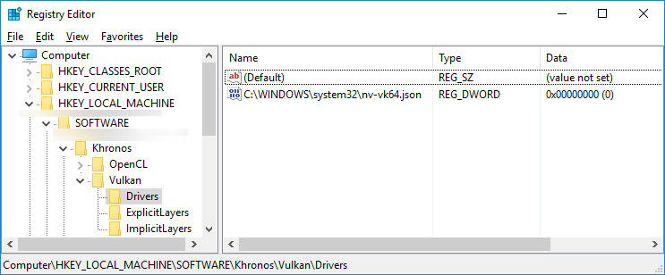
Resolving driver/layer issues
Sometimes a driver might no longer work
Such as a certain Intel Vulkan beta driver
Vulkan will fail to initialize if drivers start to fail
Find drivers section
Set data to “1”
This will disable the driver!
32-bit version is in WOW6432Node

Slide 59
Renderdoc
Official graphics debugger
Used to be GLAVE, until it was cancelled
Renderdoc is also compatible with:
D3D11
D3D12 (only just, so prolly still quite buggy)
OpenGL (definitely buggy, but not RDC’s fault)
Like any graphics debugger, gives a lot of insight into what your renderer is actually doing
… Or NOT doing!

Slide 60
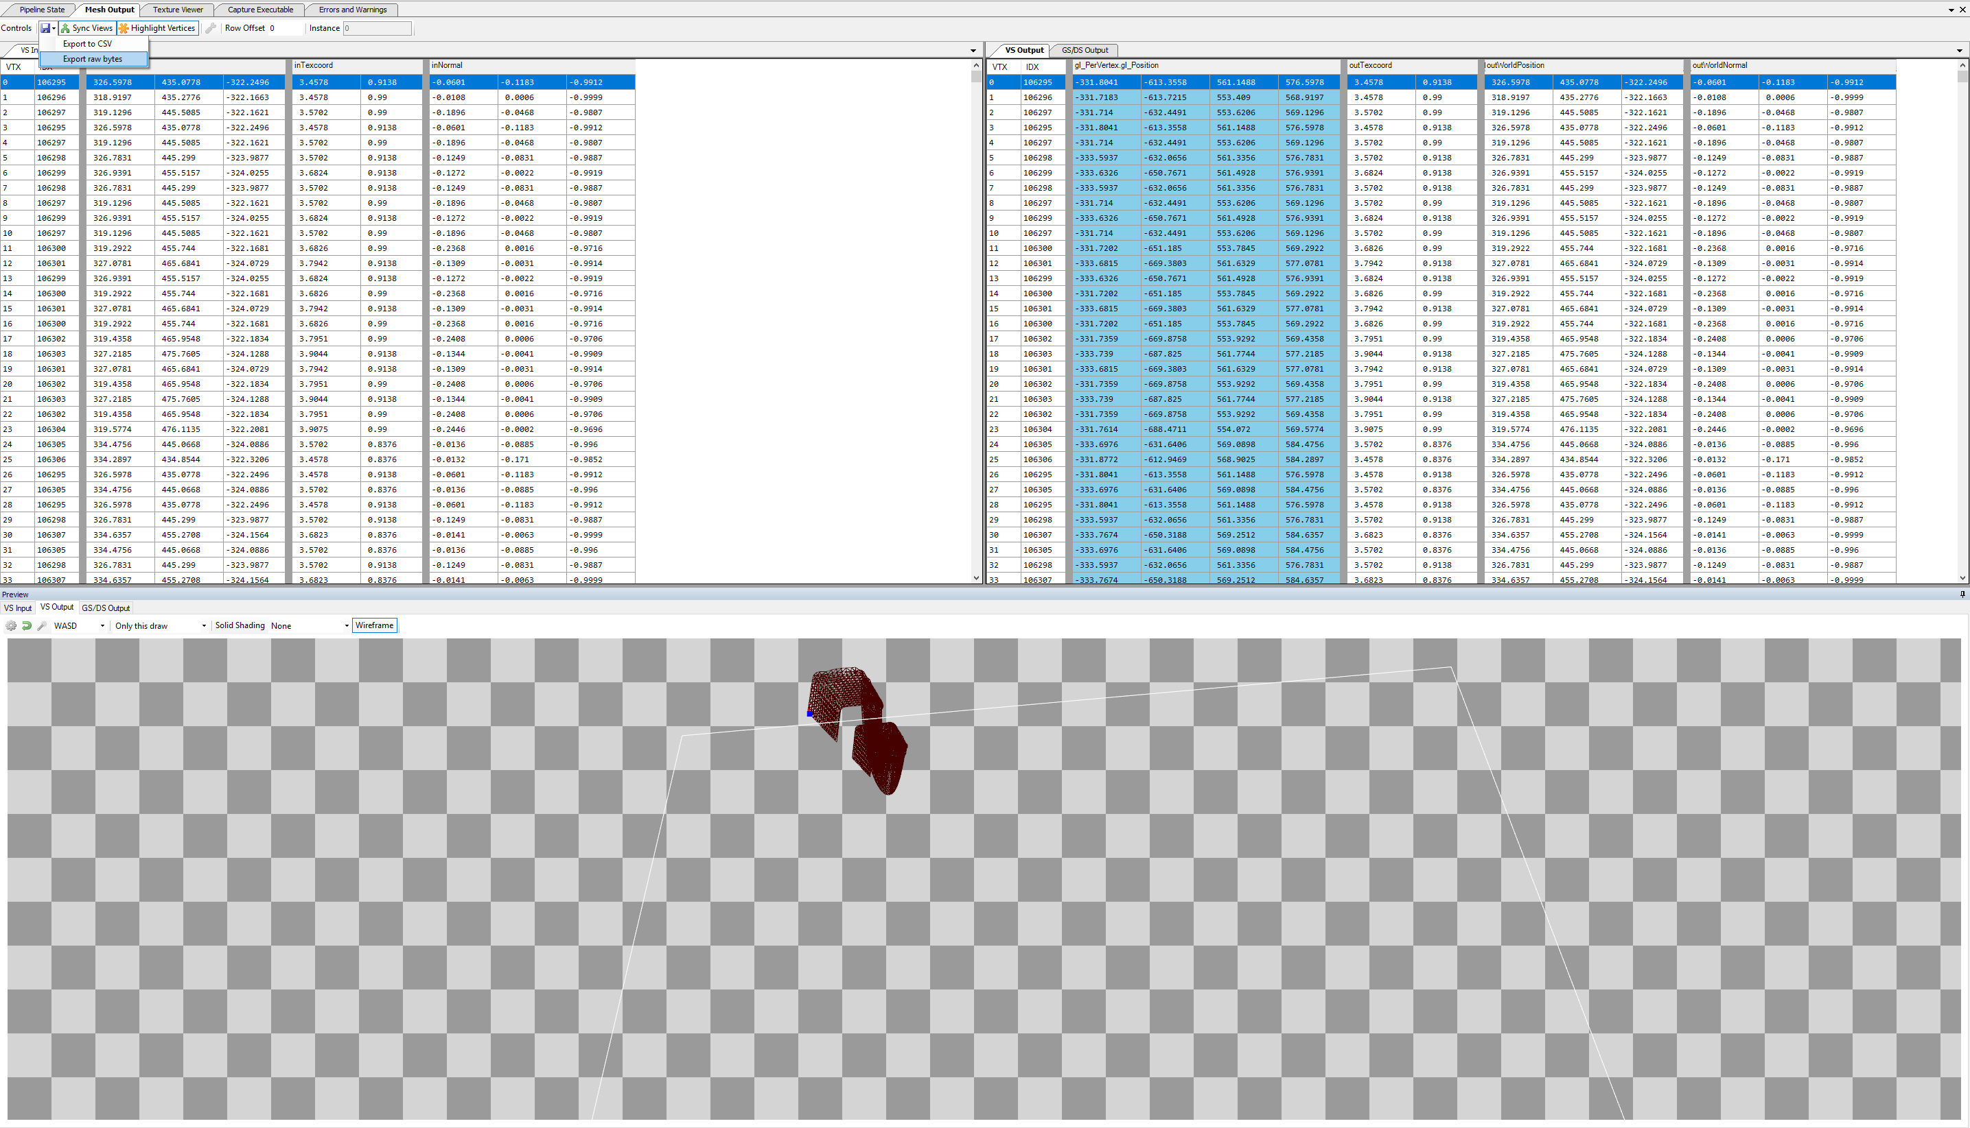
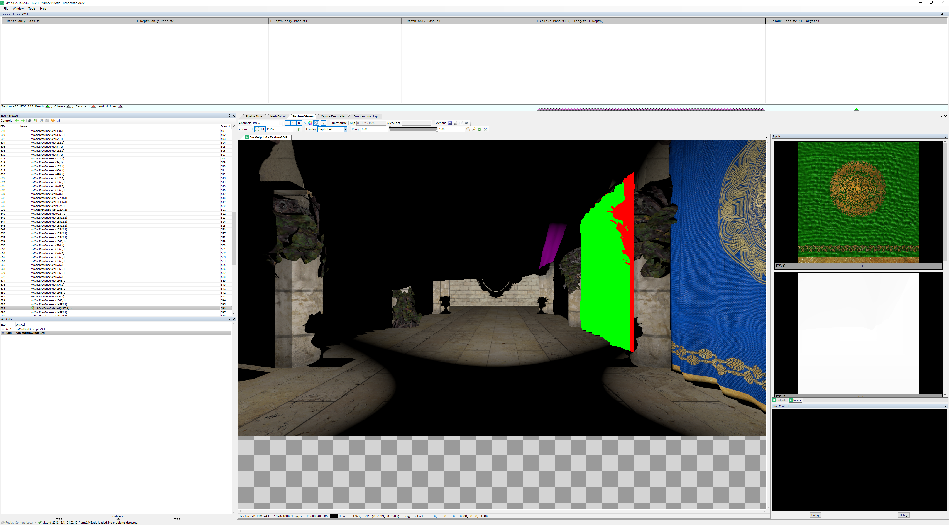
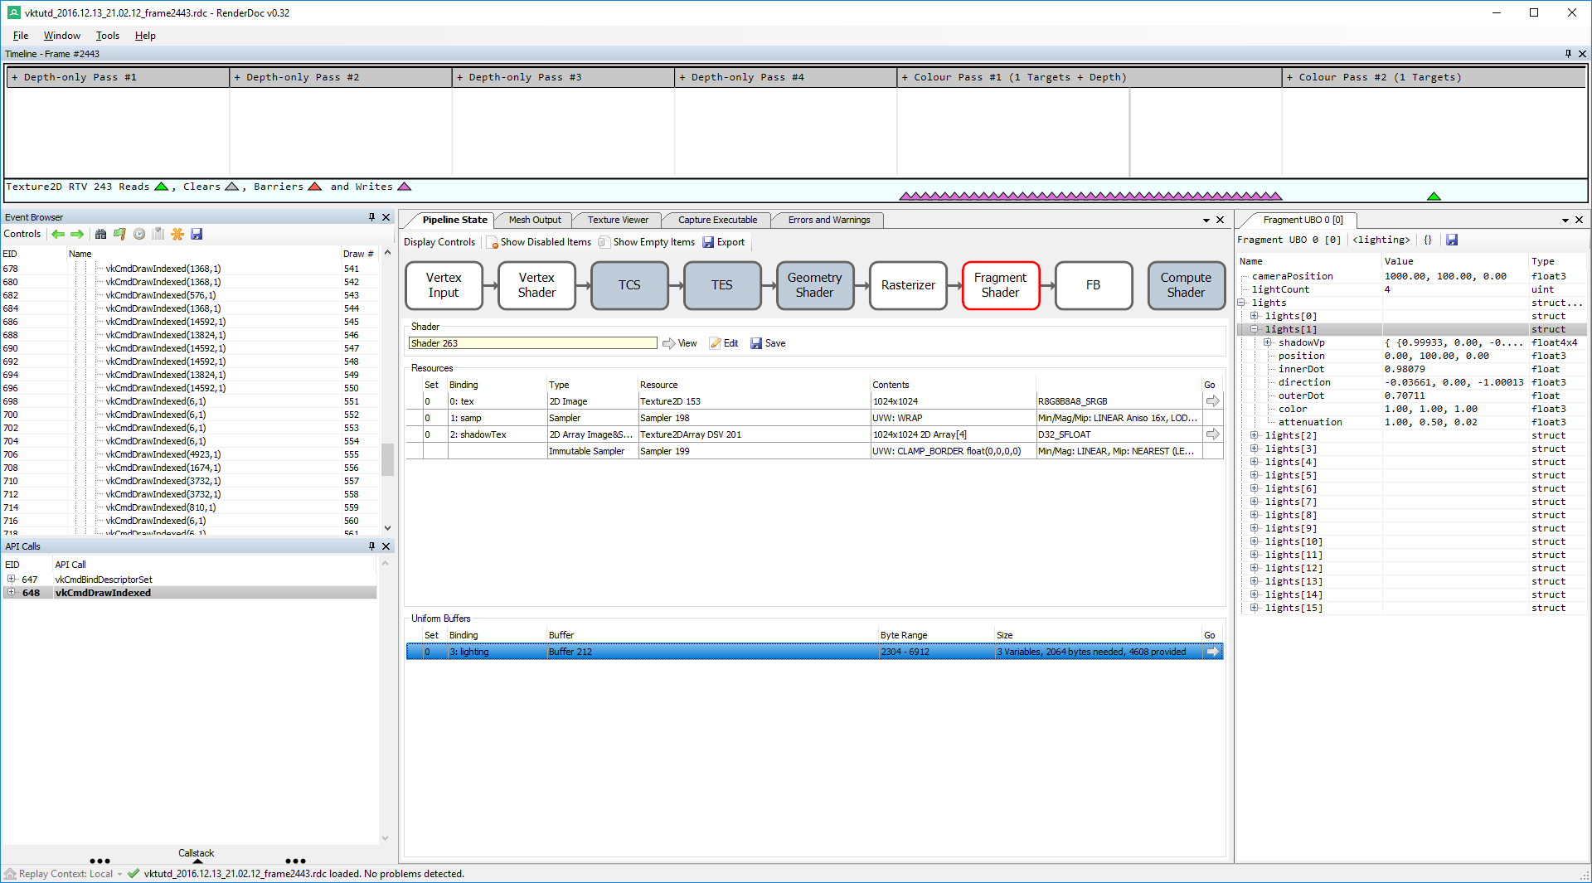
Renderdoc
Barring technical difficulties, Renderdoc should be demonstrated on the beamer now.
If it isn’t, enjoy some screenshots.

Slide 61
Renderdoc
Aside from local debugging, remote debugging is a possibility
On a remote Linux machine, for example
Android technically as well, but I couldn’t get it to work
A must install for Vulkan
And, in my opinion, for Direct3D 11 and 12 as well
Renderdoc is your best friend

Slide 62
Your real best friend
Renderdoc is actually your second best friend
Your very best friend is the Vulkan specification
https://www.khronos.org/registry/vulkan/
I definitely recommend the PDF version with all published extensions
Khronos KHR extensions if you prefer… a smaller PDF..?
I don’t see why anyone would bother with the Core API spec though
(Because remember: the function to create VkSurface and all of VkSwapchainKHR is part of an extension)

Slide 63
Other sources
Refer to the README.html file in the root of the Git repo
https://github.com/RickvanMiltenburg/vktut
I only just remembered that file even exists, will update if I don’t forget
Incidentally: I did forget

Slide 64
Is it… Is it… Over?
It is never over.
I guess that’s not true. But while the lecture part is over, the workshop begins..!

Slide 65
Slides I probably forgot to delete out of PowerPoint
Oops?

Slide 66
Texture loading
Slightly complicated compared to OGL/DX11
Textures cannot be directly mapped*
Linearly tiled textures can
Limited hardware support
Limited functionality support
Not optimal
Probably best to be avoided

Slide 67
Texture loading
Textures on GPU frequently not linear
Well-optimized for sequential, horizontal access
Poorly optimized for different Y values
Position index:
YYYY YYYY XXXX XXXX

Slide 68
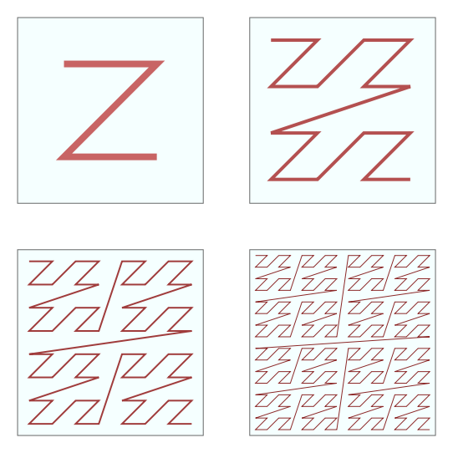
Texture loading
More commonly some variation of the Z-order (Morton) curve
Ensures greater spatial locality
Actual hardware layouts vary wildly
Position index:
YYYY YYYY XXXX XXXX
Position index:
YXYX YXYX YXYX YXYX
- Wikipedia, page: “Z-order curve”

Slide 69
Texture loading
Almost impossible to account for all layouts…
… So the API handles things differently
Linear pixel buffer
vkCmdCopy
BufferToImage
“Optimal” image
vkCreateBuffer
vkAllocateMemory
vkMap/UnmapMemory
vkBindBufferMemory
vkCmdStart/EndCommandBuffer
vkCmdPipelineBarrier
vkCmdCopyBufferToImage
vkQueueSubmit
vkCreateImage
vkAllocateMemory
vkBindImageMemory
vkCreateImageView

Slide 70
State management
GPU rendering has lots of configuration properties
Etc etc etc
Shaders | Vertex input | Viewport | Scissor | Primitive type | Tesselation properties
Blending on/off | Blend function | Color targets | Color output mask | Cull mode | Multisampling
Depth testing | Depth testing function | Depth testing bias | Depth writing | Depth writing bias | Depth bounds

Slide 71
State management
All properties can have an effect on how the hardware renders
Kind of their purpose!
Allowing free changing of properties allows a lot of combinations
Can be hard to optimize for
Solution:
… Don’t

Slide 72
State management
OpenGL had many different setting functions which could be called individually, leading to many calls for many state changes
glPrimitive | glViewport | glBindShader | glScissor | glSet…

Slide 73
Direct3D 11 had a set of state objects grouping sets of properties together, reducing the amount of calls and internal state changes
SetRasterizerState | SetBlendState | SetVSShader | SetDepthStencilState | Set…

Slide 74
Direct3D 12 and Vulkan opt for one, single, enourmous object combining EVERYTHING and the kitchen sink
vkSetPipelineState
SetPipelineState

Slide 75
One big object allows driver to optimize
Allows the programmer to ensure no RT shader recompiles occur
Reduces the amount of calls and internal overhead for rendering
… But is a fairly large codesize overhead
And requires thought to do properly in your codebases!

